Slide 1
the goal of my participation in this course
Walk in the shoes of my target audiences –
the research community & internal development teams.
Data Generators -- Data Use Facilitators -- Data Users .
Prove to myself I can learn something totally new and
use it to create something potentially useful.
Learn to be able to do or create something scientifically significant
and of relevance to the people that I work with –
both internally and externally.

Slide 2
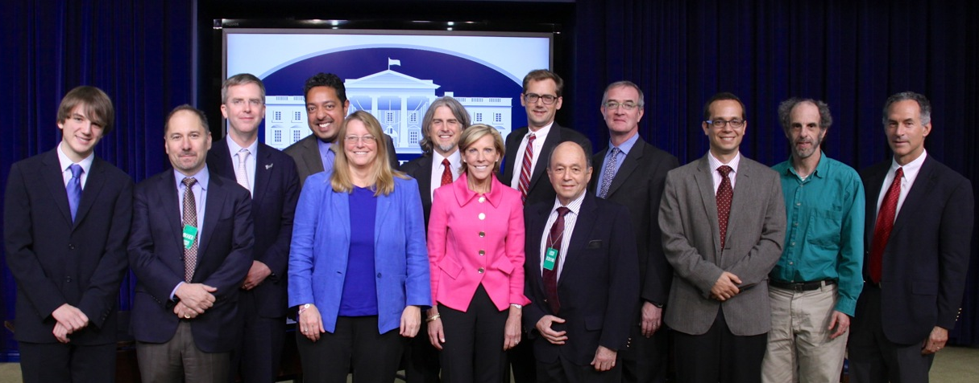

Open Science
Champions of Change

Slide 3
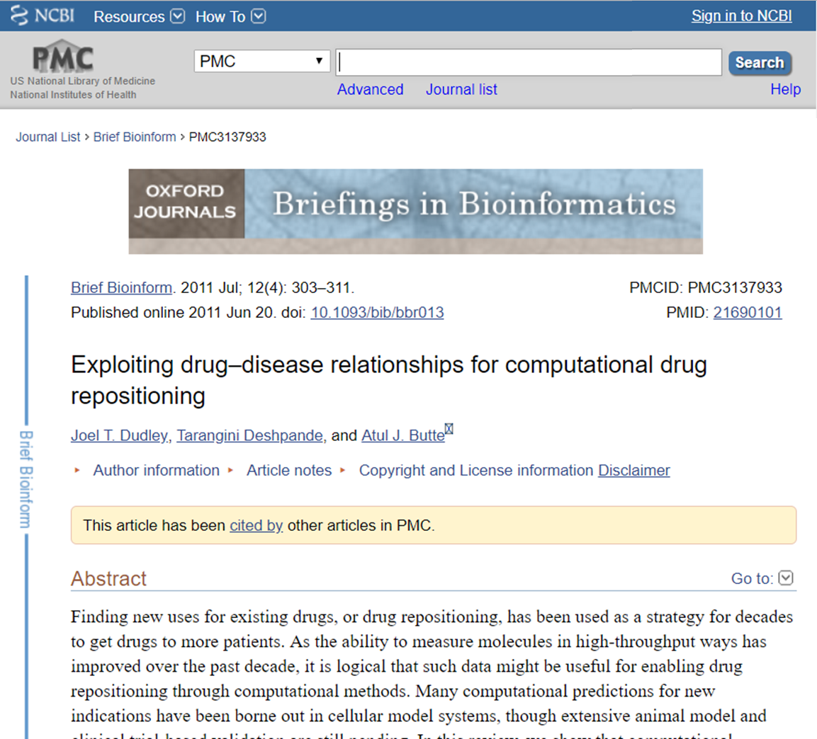
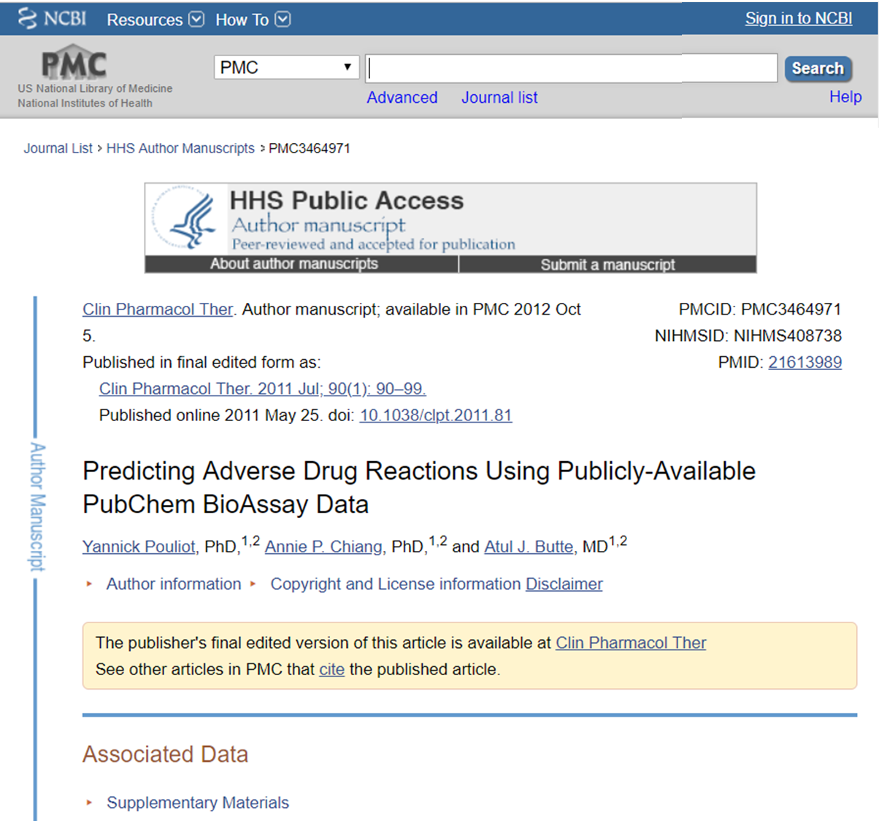
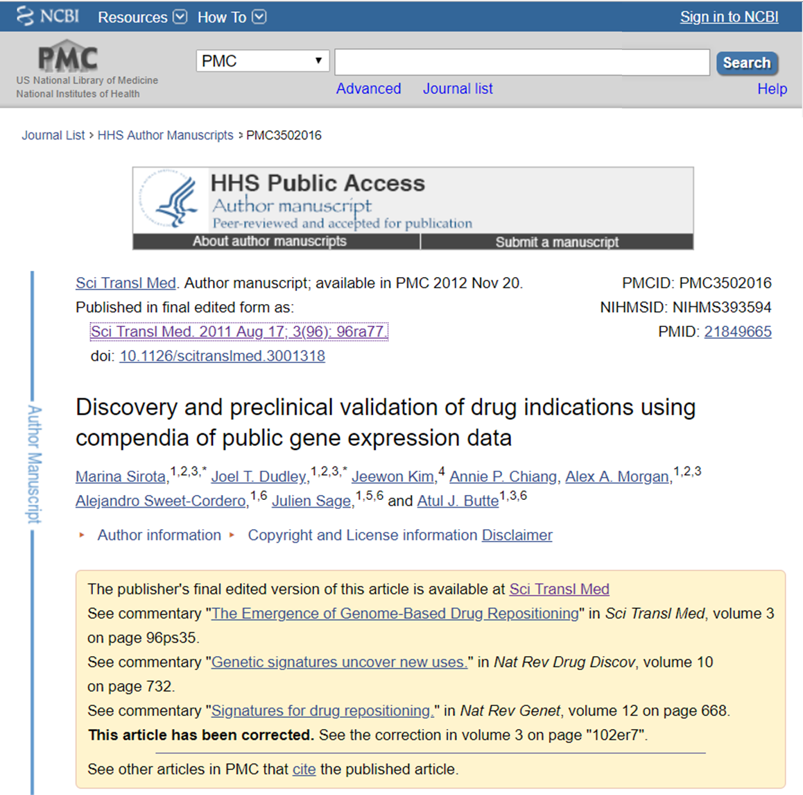
Open Science
Champions of Change

Slide 4

the goal of this final (capstone) project
NLM Resources span the lifecycle
of medications development:
MedGen
Gene
PubChem
DailyMed
(and others)
Create a prototype pipeline for the
discovery of novel gene-targeting drug candidates.
Drug candidate recommendations could be shared with collaborators or be made available in NLM resources to assist researchers with an evidence-based starting point for new drug discovery.

Slide 5
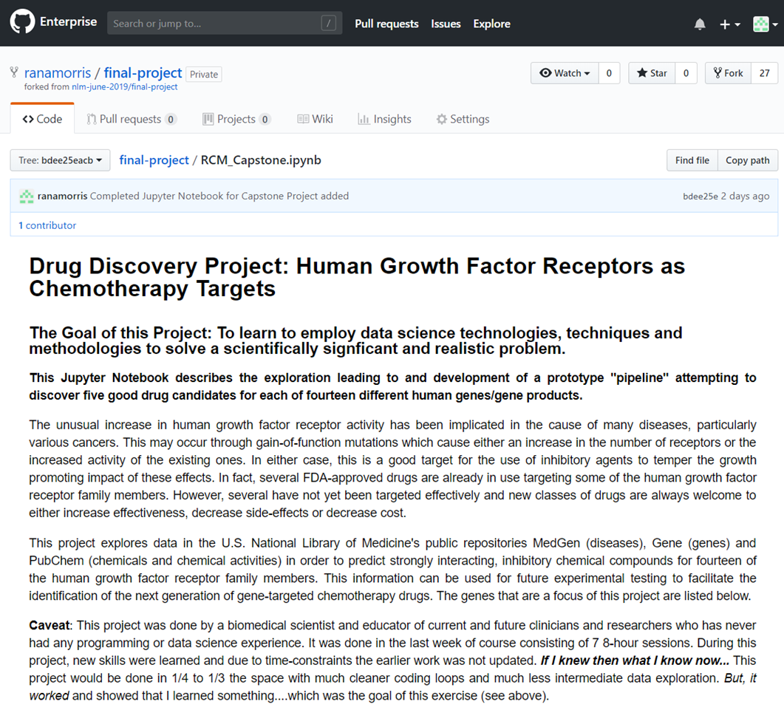
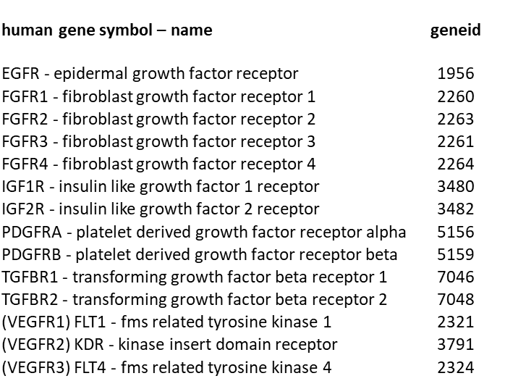
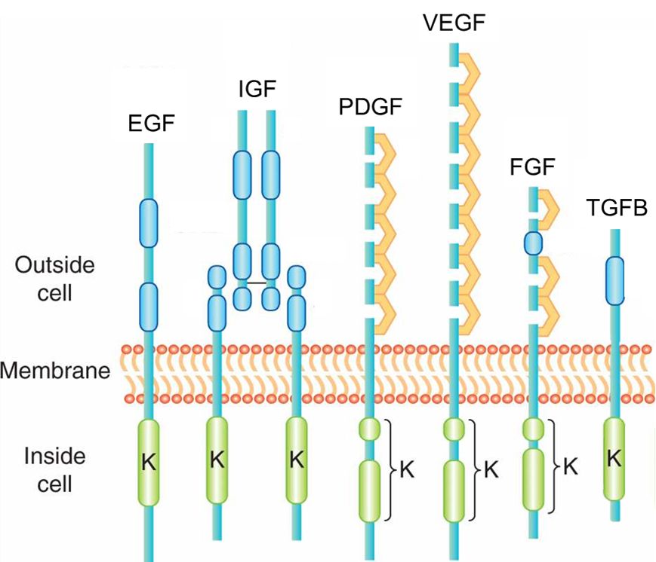

Slide 6

project plan: create a pilot drug discovery pipeline to propose good drug candidates for specific genes
Assess
target-geneid
interactions
Acquire
& prepare
geneid → cid
datasets
Assess
off-target geneid interactions
Propose drug candidates
Acquire & prepare
cid → geneid
datasets
96+ million Compounds & 1+ million BioAssays in PubChem

Slide 7
project plan: create a pilot drug discovery pipeline to propose good drug candidates for specific genes
Asta’s APIs
Where can I get
a lot of good quality
gene target – chemical
interaction data?
Assess
target-geneid
interactions
Acquire
& prepare
geneid → cid
datasets
Assess
off-target geneid interactions
Propose drug candidates
Acquire & prepare
cid → geneid
datasets
96+ million Compounds & 1+ million BioAssays in PubChem

Slide 8
project plan: create a pilot drug discovery pipeline to propose good drug candidates for specific genes
Asta’s APIs
Where can I get
a lot of good quality
gene target – chemical
interaction data?
Assess
target-geneid
interactions
Acquire
& prepare
geneid → cid
datasets
Assess
off-target geneid interactions
Propose drug candidates
Acquire & prepare
cid → geneid
datasets
Looks good!
96+ million Compounds & 1+ million BioAssays in PubChem

Slide 9
project plan: create a pilot drug discovery pipeline to propose good drug candidates for specific genes
Asta’s APIs
Where can I get
a lot of good quality
gene target – chemical
interaction data?
Assess
target-geneid
interactions
Acquire
& prepare
geneid → cid
datasets
Assess
off-target geneid interactions
Propose drug candidates
Acquire & prepare
cid → geneid
datasets
Looks good!
96+ million Compounds & 1+ million BioAssays in PubChem
Can I find chemicals with evidence
of good binding/inhibition
to the target-gene/gene product?
EFFICACY

Slide 10
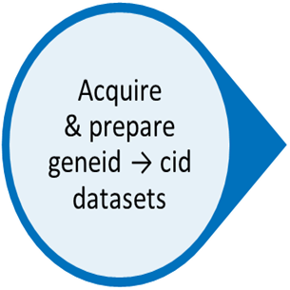
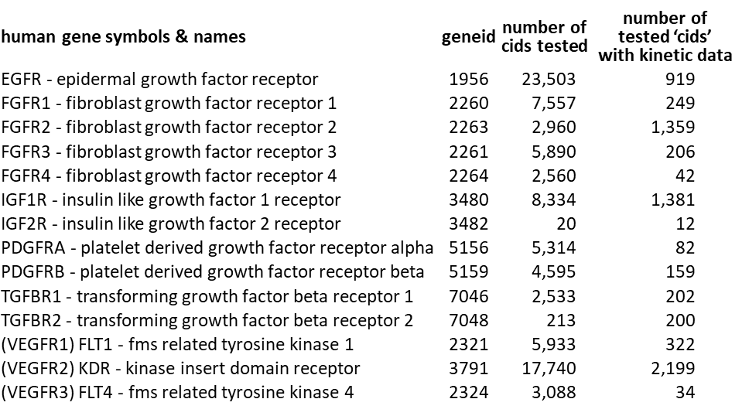
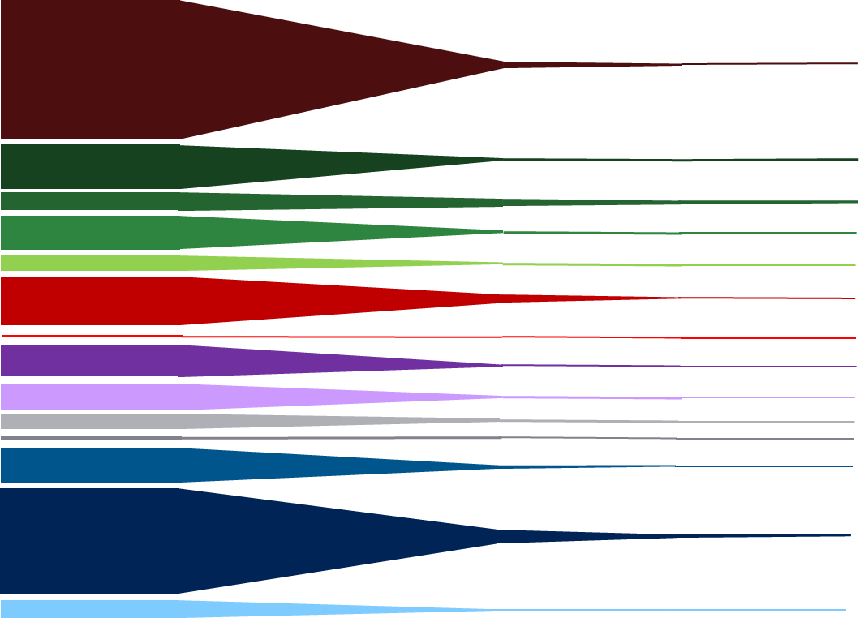
acquire & prepare geneid → cid datasets
summarizing the DataFrame
96+ million Compounds & 1+ million BioAssays in PubChem
1956
2260
2263
2261
2264
3480
3482
5156
5159
7048
7046
2321
3791
2324

Slide 11
project plan: create a pilot drug discovery pipeline to propose good drug candidates for specific genes
Asta’s APIs
Where can I get
a lot of good quality
gene target – chemical
interaction data?
Assess
target-geneid
interactions
Acquire
& prepare
geneid → cid
datasets
Assess
off-target geneid interactions
Propose drug candidates
Acquire & prepare
cid → geneid
datasets
Looks good!
96+ million Compounds & 1+ million BioAssays in PubChem
Can I find chemicals with evidence
of good binding/inhibition
to the target-gene/gene product?
EFFICACY

Slide 12
project plan: create a pilot drug discovery pipeline to propose good drug candidates for specific genes
Asta’s APIs
Where can I get
a lot of good quality
gene target – chemical
interaction data?
Assess
target-geneid
interactions
Acquire
& prepare
geneid → cid
datasets
Assess
off-target geneid interactions
Propose drug candidates
Acquire & prepare
cid → geneid
datasets
Looks good!
96+ million Compounds & 1+ million BioAssays in PubChem
Can I find chemicals with evidence
of good binding/inhibition
to the target-gene/gene product?
EFFICACY

Slide 13
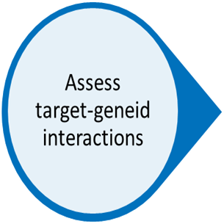
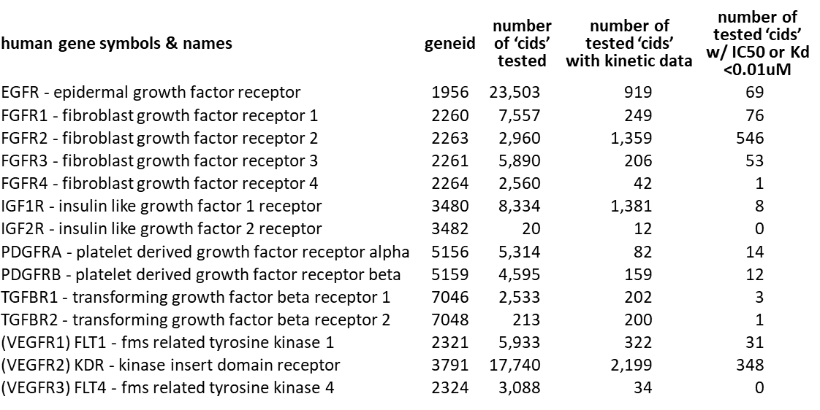
assess target-geneid interactions: starting at a threshold of 0.010uM
96+ million Compounds & 1+ million BioAssays in PubChem
.str.contains('IC50', 'Kd', na=False)]
.groupby(‘geneid’)
1956
2260
2263
2261
2264
3480
3482
5156
5159
7048
7046
2321
3791
2324

Slide 14
project plan: create a pilot drug discovery pipeline to propose good drug candidates for specific genes
Asta’s APIs
Where can I get
a lot of good quality
gene target – chemical
interaction data?
Assess
target-geneid
interactions
Acquire
& prepare
geneid → cid
datasets
Assess
off-target geneid interactions
Propose drug candidates
Acquire & prepare
cid → geneid
datasets
Looks good!
96+ million Compounds & 1+ million BioAssays in PubChem
Can I find chemicals with evidence
of good binding/inhibition
to the target-gene/gene product?
EFFICACY
Baseline: IC50/Kd < 10nM
Then optimize to get a
manageable number
of lead compounds!

Slide 15
assess target-geneid interactions: starting at a threshold of 0.010uM
96+ million Compounds & 1+ million BioAssays in PubChem
['acvalue']<0.01]
.groupby(‘geneid’)
1956
2260
2263
2261
2264
3480
3482
5156
5159
7048
7046
2321
3791
2324

Slide 16
project plan: create a pilot drug discovery pipeline to propose good drug candidates for specific genes
Asta’s APIs
Where can I get
a lot of good quality
gene target – chemical
interaction data?
Assess
target-geneid
interactions
Acquire
& prepare
geneid → cid
datasets
Assess
off-target geneid interactions
Propose drug candidates
Acquire & prepare
cid → geneid
datasets
Looks good!
96+ million Compounds & 1+ million BioAssays in PubChem
Can I find chemicals with evidence
of good binding/inhibition
to the target-gene/gene product?
EFFICACY
Baseline: IC50/Kd < 10nM
Then optimize to get a
manageable number
of lead compounds!

Slide 17
assess target-geneid interactions: starting at a threshold of 0.010uM
96+ million Compounds & 1+ million BioAssays in PubChem
['acvalue']<0.01]
.groupby(‘geneid’)
1956
2260
2263
2261
2264
3480
3482
5156
5159
7048
7046
2321
3791
2324

Slide 18
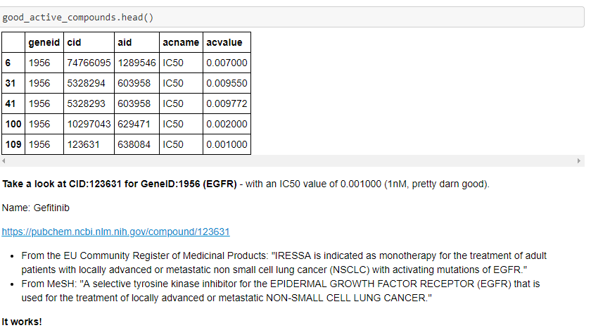
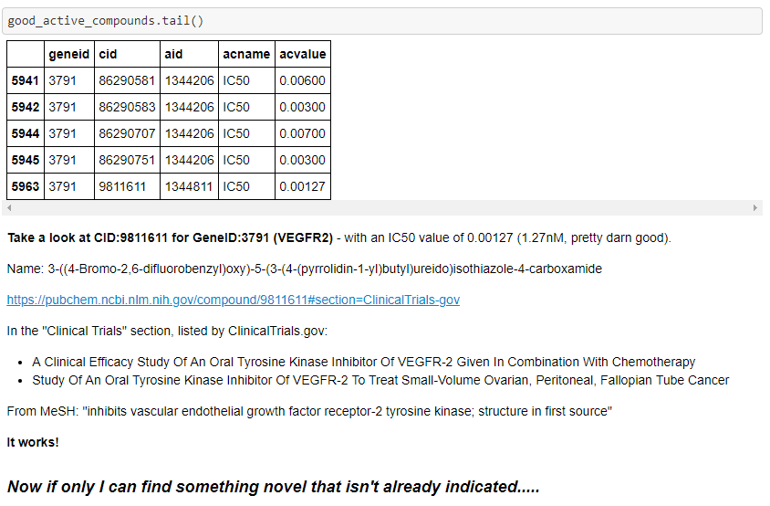
assess target-geneid interactions: SPOT CHECK
Using the good_active_compounds file, I randomly selected two ‘cids' from the top and from the bottom of the list,
and looked each up in the PubChem Compound database to look for any indication of known activity against each's target gene/gene product.
https://pubchem.ncbi.nlm.nih.gov/compound/123631
https://pubchem.ncbi.nlm.nih.gov/compound/9811611
CID:123631 & GeneID:1956 (EGFR)
From the EU Community Register of Medicinal Products: "IRESSA is indicated as monotherapy for the treatment of adult patients with locally advanced or metastatic non small cell lung cancer (NSCLC) with activating mutations of EGFR."
From MeSH: "A selective tyrosine kinase inhibitor for the EPIDERMAL GROWTH FACTOR RECEPTOR (EGFR) that is used for the treatment of locally advanced or metastatic NON-SMALL CELL LUNG CANCER."
CID:9811611 & GeneID:3791 (VEGFR2)
In the "Clinical Trials" section, listed by ClinicalTrials.gov:
A Clinical Efficacy Study Of An Oral Tyrosine Kinase Inhibitor Of VEGFR-2 Given In Combination With Chemotherapy
Study Of An Oral Tyrosine Kinase Inhibitor Of VEGFR-2 To Treat Small-Volume Ovarian, Peritoneal, Fallopian Tube Cancer
From MeSH: "inhibits vascular endothelial growth factor receptor-2 tyrosine kinase; structure in first source"
If only I could find something novel that isn’t already a drug or drug candidate….
Let’s get rid of all drugs from my list!

Slide 19
project plan: create a pilot drug discovery pipeline to propose good drug candidates for specific genes
Asta’s APIs
Where can I get
a lot of good quality
gene target – chemical
interaction data?
Assess
target-geneid
interactions
Acquire
& prepare
geneid → cid
datasets
Assess
off-target geneid interactions
Propose drug candidates
Acquire & prepare
cid → geneid
datasets
Looks good!
96+ million Compounds & 1+ million BioAssays in PubChem
Can I find chemicals with evidence
of good binding/inhibition
to the target-gene/gene product?
EFFICACY
Baseline: IC50/Kd < 10nM
Then optimize to get a
manageable number
of lead compounds!

Slide 20
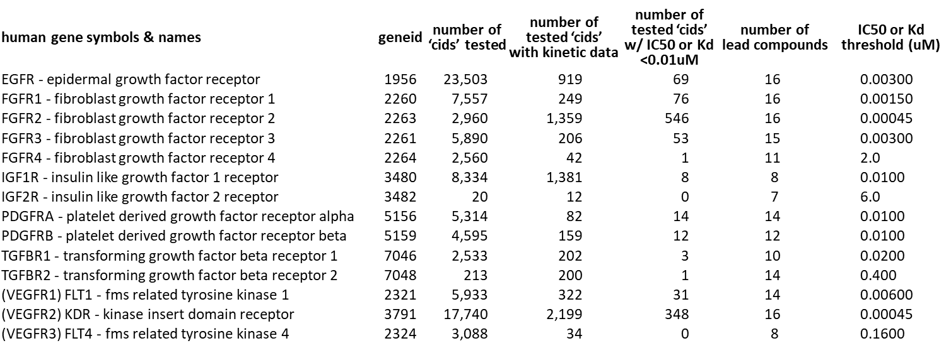
assess target-geneid interactions: optimize a list of lead compounds
96+ million Compounds & 1+ million BioAssays in PubChem
1956
['acvalue’]<..varies..]
2260
.groupby(‘geneid’)
2263
2261
2264
3480
3482
5156
5159
7048
7046
2321
3791
2324

Slide 21
project plan: create a pilot drug discovery pipeline to propose good drug candidates for specific genes
Asta’s APIs
Asta’s APIs
Where can I get
a lot of good quality
gene target – chemical
interaction data?
Where can I get
a lot of good quality
chemical-gene/gene product interaction data
Assess
target-geneid
interactions
Acquire
& prepare
geneid → cid
datasets
Assess
off-target geneid interactions
Propose drug candidates
Acquire & prepare
cid → geneid
datasets
Looks good!
96+ million Compounds & 1+ million BioAssays in PubChem
Can I find chemicals with evidence
of good binding/inhibition
to the target-gene/gene product?
EFFICACY
Baseline: IC50/Kd < 10nM
Then optimize to get a
manageable number
of lead compounds!

Slide 22
project plan: create a pilot drug discovery pipeline to propose good drug candidates for specific genes
Asta’s APIs
Asta’s APIs
Where can I get
a lot of good quality
gene target – chemical
interaction data?
Where can I get
a lot of good quality
chemical-gene/gene product interaction data
Assess
target-geneid
interactions
Acquire
& prepare
geneid → cid
datasets
Assess
off-target geneid interactions
Propose drug candidates
Acquire & prepare
cid → geneid
datasets
Looks good!
96+ million Compounds & 1+ million BioAssays in PubChem
Can I find chemicals with evidence
of good binding/inhibition
to the target-gene/gene product?
EFFICACY
Can I find out if certain chemicals bind/inhibit other
(off-target) gene/gene products?
SPECIFICITY
Baseline: IC50/Kd < 10nM
Then optimize to get a
manageable number
of lead compounds!

Slide 23
project plan: create a pilot drug discovery pipeline to propose good drug candidates for specific genes
Asta’s APIs
Asta’s APIs
Where can I get
a lot of good quality
gene target – chemical
interaction data?
Where can I get
a lot of good quality
chemical-gene/gene product interaction data
There is some good multi-gene data
Assess
target-geneid
interactions
Acquire
& prepare
geneid → cid
datasets
Assess
off-target geneid interactions
Propose drug candidates
Acquire & prepare
cid → geneid
datasets
Looks good!
96+ million Compounds & 1+ million BioAssays in PubChem
Can I find chemicals with evidence
of good binding/inhibition
to the target-gene/gene product?
EFFICACY
Works on positive controls!
Can I find out if certain chemicals bind/inhibit other
(off-target) gene/gene products?
SPECIFICITY
Baseline: IC50/Kd < 10nM
Then optimize to get a
manageable number
of lead compounds!

Slide 24
project plan: create a pilot drug discovery pipeline to propose good drug candidates for specific genes
Asta’s APIs
Asta’s APIs
Where can I get
a lot of good quality
gene target – chemical
interaction data?
Where can I get
a lot of good quality
chemical-gene/gene product interaction data
There is some good multi-gene data
Assess
target-geneid
interactions
Acquire
& prepare
geneid → cid
datasets
Assess
off-target geneid interactions
Propose drug candidates
Acquire & prepare
cid → geneid
datasets
Looks good!
96+ million Compounds & 1+ million BioAssays in PubChem
Can I find chemicals with evidence
of good binding/inhibition
to the target-gene/gene product?
EFFICACY
Works on positive controls!
Can I find out if certain chemicals bind/inhibit other
(off-target) gene/gene products?
SPECIFICITY
Baseline: IC50/Kd < 10nM
Then optimize to get a
manageable number
of lead compounds!
Cross-reference IC50/Kd values
for any other gene tested.
Then select based on
lack of off-target impact
and strong IC50/Kd value

Slide 25
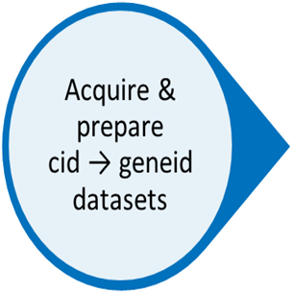
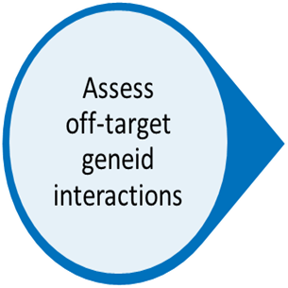

propose drug candidates
human gene symbols & names | geneid | number of ‘cids’ tested | number of tested ‘cids’ with kinetic data | number of tested ‘cids’ w/ IC50 or Kd <0.01uM | number of lead compounds | IC50 or Kd threshold (uM) | number of drug candidates | IC50/Kd range of drug candidates (nM) | number of off-target genes tested
EGFR - epidermal growth factor receptor | 1956 | 23,503 | 919 | 69 | 16 | 0.00300 | 5 | 1.0 - 2.0 | 49
FGFR1 - fibroblast growth factor receptor 1 | 2260 | 7,557 | 249 | 76 | 16 | 0.00150 | 5 | 0.50 - 0.9 | 7
FGFR2 - fibroblast growth factor receptor 2 | 2263 | 2,960 | 1,359 | 546 | 16 | 0.00045 | 5 | 0.10 - 2.0 | 11
FGFR3 - fibroblast growth factor receptor 3 | 2261 | 5,890 | 206 | 53 | 15 | 0.00300 | 5 | 0.20 - 2.5 | 2
FGFR4 - fibroblast growth factor receptor 4 | 2264 | 2,560 | 42 | 1 | 11 | 2.0 | 5 | 0.20 - 1,500 | 177
IGF1R - insulin like growth factor 1 receptor | 3480 | 8,334 | 1,381 | 8 | 8 | 0.0100 | 5 | 3.0 - 8.0 | 6
IGF2R - insulin like growth factor 2 receptor | 3482 | 20 | 12 | 0 | 7 | 6.0 | 5 | 850 - 4,760 | 3
PDGFRA - platelet derived growth factor receptor alpha | 5156 | 5,314 | 82 | 14 | 14 | 0.0100 | 5 | 2.0 - 5.0 | 383
PDGFRB - platelet derived growth factor receptor beta | 5159 | 4,595 | 159 | 12 | 12 | 0.0100 | 5 | 0.20 - 6.0 | 386
TGFBR1 - transforming growth factor beta receptor 1 | 7046 | 2,533 | 202 | 3 | 10 | 0.0200 | 5 | 6.0 – 130 | 283
TGFBR2 - transforming growth factor beta receptor 2 | 7048 | 213 | 200 | 1 | 14 | 0.400 | 5 | 26 – 230 | 422
(VEGFR1) FLT1 - fms related tyrosine kinase 1 | 2321 | 5,933 | 322 | 31 | 14 | 0.00600 | 5 | 2.0 - 4.0 | 7
(VEGFR2) KDR - kinase insert domain receptor | 3791 | 17,740 | 2,199 | 348 | 16 | 0.00045 | 5 | 0.06 - 2.0 | 17
(VEGFR3) FLT4 - fms related tyrosine kinase 4 | 2324 | 3,088 | 34 | 0 | 8 | 0.1600 | 5 | 18 - 29 | 176
96,105,154 Chemicals in the PubChem Compound database
1956
5
2260
5
2263
5
2261
5
2264
5
3480
5
3482
5
5156
5
5159
5
7048
5
7046
5
2321
5
3791
5
2324
5

Slide 26

project plan: create a pilot drug discovery pipeline to propose good drug candidates for specific genes
Asta’s APIs
Asta’s APIs
Where can I get
a lot of good quality
gene target – chemical
interaction data?
Where can I get
a lot of good quality
chemical-gene/gene product interaction data
There is some good multi-gene data
Assess
target-geneid
interactions
Acquire
& prepare
geneid → cid
datasets
Assess
off-target geneid interactions
Propose drug candidates
Acquire & prepare
cid → geneid
datasets
Looks good!
96+ million Compounds & 1+ million BioAssays in PubChem
Can I find chemicals with evidence
of good binding/inhibition
to the target-gene/gene product?
EFFICACY
Works on positive controls!
Can I find out if certain chemicals bind/inhibit other
(off-target) gene/gene products?
SPECIFICITY
Baseline: IC50/Kd < 10nM
Then optimize to get a
manageable number
of lead compounds!
Cross-reference IC50/Kd values
for any other gene tested.
Then select based on
lack of off-target impact
and strong IC50/Kd value

Slide 27
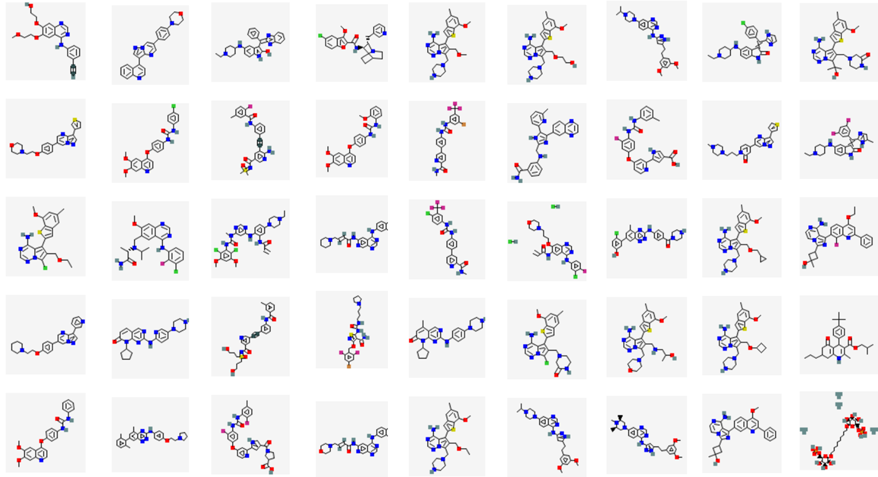
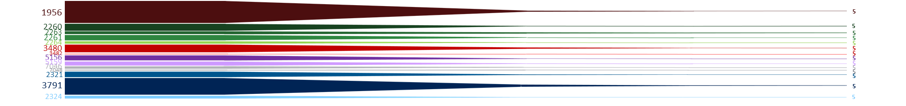
project summary
Assess
target-geneid
interactions
Acquire
& prepare
geneid → cid
datasets
Propose drug candidates
Acquire & prepare
cid → geneid
datasets
Assess
off-target geneid interactions
96,105,154 Chemicals in the PubChem Compound database
genes

Slide 28
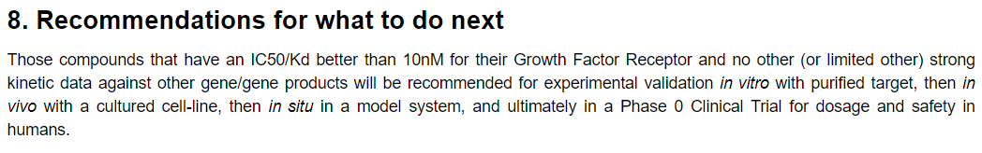

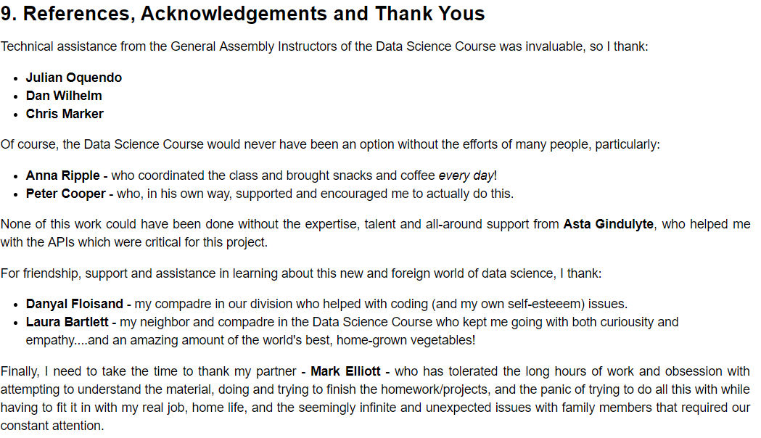
8.1 Recommendations for what I should do next
Consider cleaning up and repackaging the code….now that I know now….and suggest this for a larger drug discovery project.

Slide 29
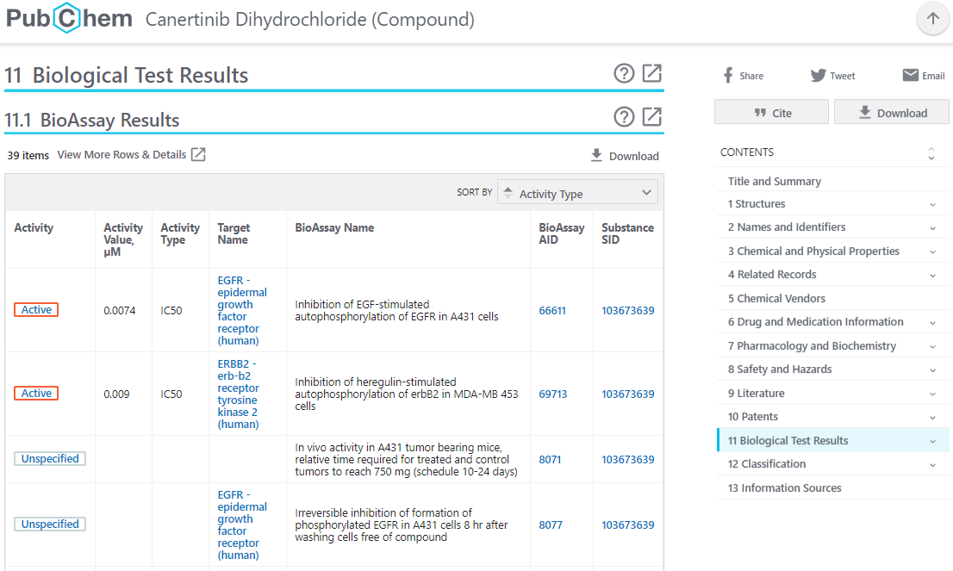
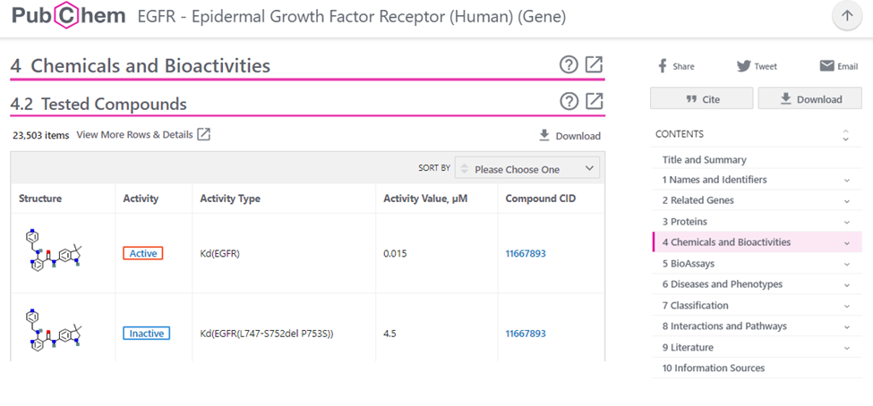
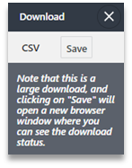

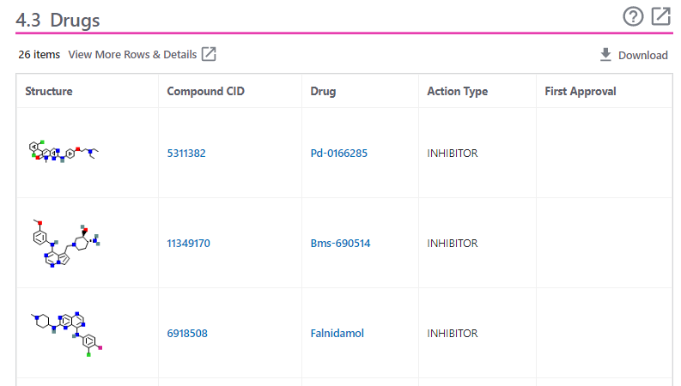
acquire & prepare geneid → cid datasets Asta’s APIs
New “hidden” PubChem APIs to support their new web design.
96+ million Compounds & 1+ million BioAssays in PubChem
3

Slide 30
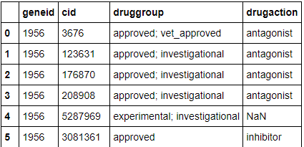
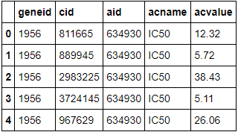
acquire & prepare geneid → cid datasets use Asta’s APIs!
https://pubchem.ncbi.nlm.nih.gov/sdq/sdqagent.cgi?infmt=json&outfmt=jsonp
&query={"download":[“specify columns"],"collection":“specify type", "where":{"ands":[{"geneid":"GENEID-GOES-HERE"}]}, "order":[“if you are interested in this"],
"start":1,"limit":1000000}
Tested Compounds
Drugs
“download":["geneid","cid","aid","acname","acvalue"],
"collection":"bioactivity”
{"cid":"notnull"},{"acname":"notnull"},{"acvalue":"notnull"}]}
“download":["geneid","cid","druggroup","drugaction"],
"collection":"drugbank”

Slide 31
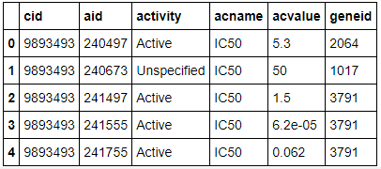
acquire & prepare cid → geneid datasets: Asta’s APIs
https://pubchem.ncbi.nlm.nih.gov/sdq/sdqagent.cgi?infmt=json&outfmt=jsonp
&query={"download":[“specify columns"],
"collection":“specify type", "where":{"ands":[{“cid":“CID-GOES-HERE"}]}, "order":[“if you are interested in this"],
"start":1,"limit":1000000}
96+ million Compounds & 1+ million BioAssays in PubChem
“download":["cid","aid","activity","acname","acvalue", "geneid"],
"collection":"bioactivity
{"geneid":"notnull"},{"acname":"notnull"},
{"acvalue":"notnull"},{"activity":"notnull"}
“Now that I know…with a little-bit-o-help…”

Slide 32
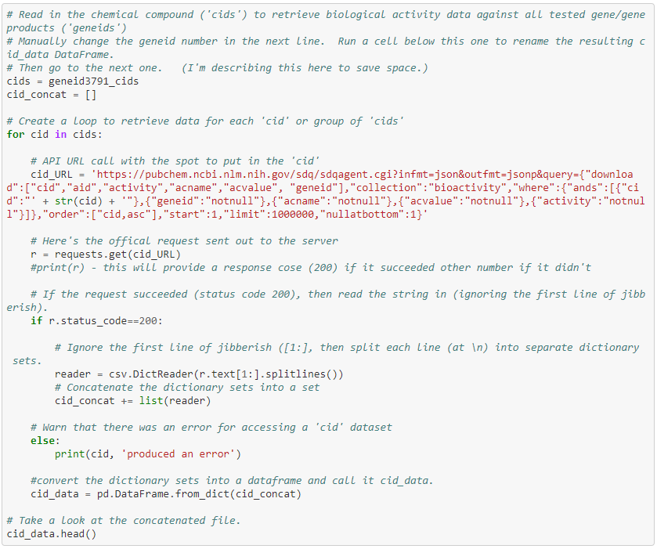
acquire & prepare geneid → cid datasets with a for-loop! . (Thanks,Dan!)

Slide 33
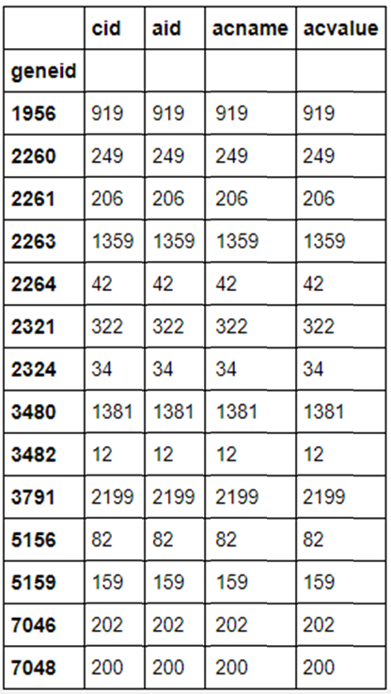
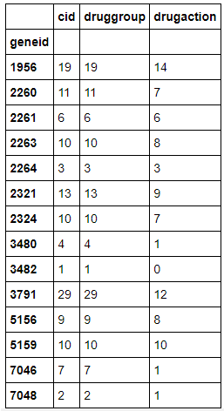
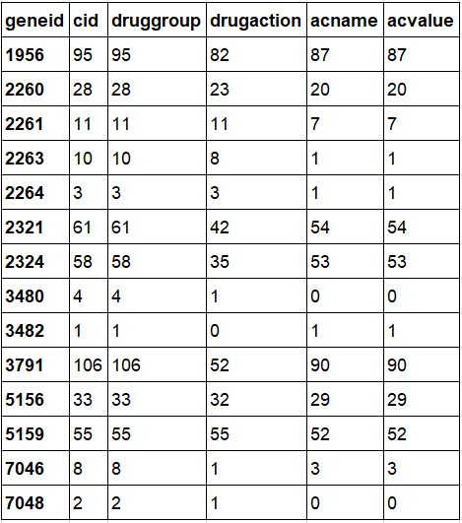
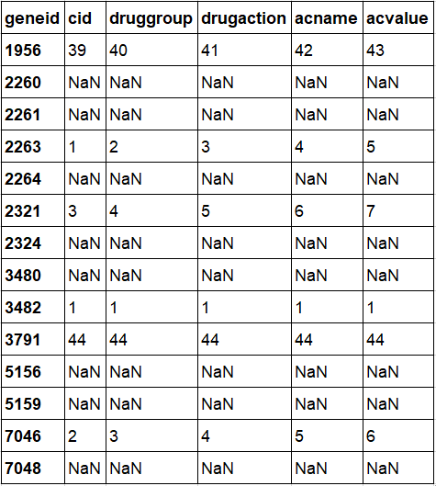
acquire & prepare geneid → cid datasets create the initial DataFrames
Tested Compounds
Drugs
Drugs with Testing Data
.groupby(‘geneid’)
pd.concat
pd.merge(x,y,on =‘cid’,how=‘left’)
.groupby(‘geneid’)
Filtered for cid’s tested
against the specific geneid

Slide 34
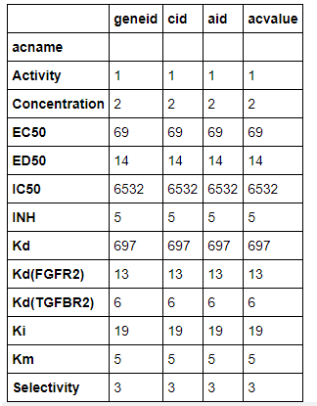
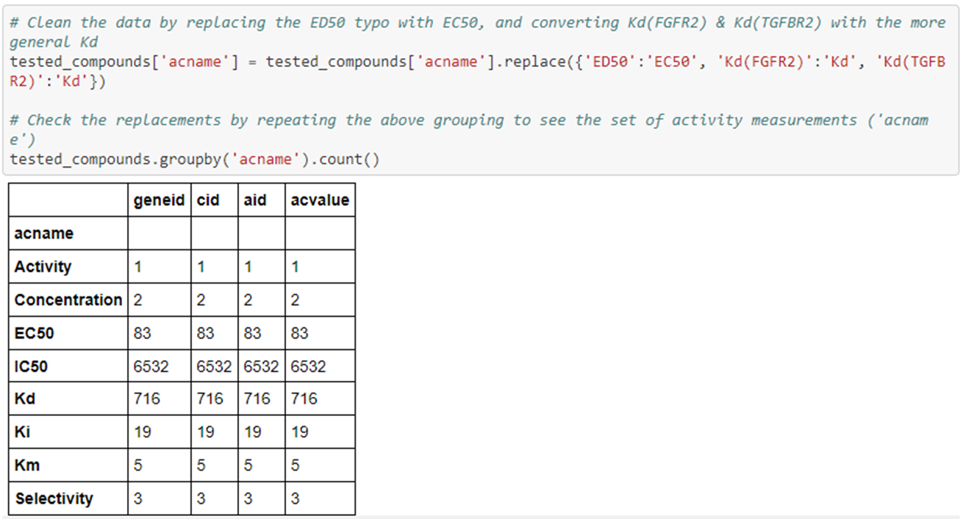
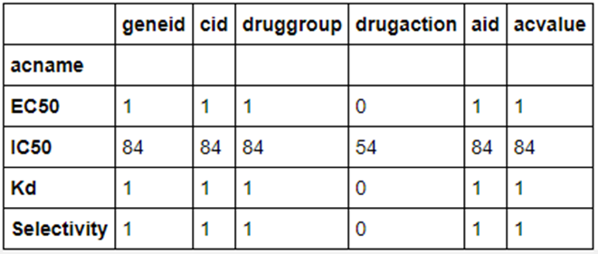
acquire & prepare geneid → cid datasets
cleaning the DataFrames
Asta’s APIs enable pre-filtering the data to filter-out “null values”!
Clustering the data to find & use replace to fix:
typos (ED40) & non-standard terms (Kd(genesymbol))
Tested Compounds
Drugs with Testing Data
.groupby(‘acname’)
?

Slide 35
check for useful information: what data do we have that we can use?
‘geneid’ (target gene…the one I am trying to target a drug)
‘cid’ (chemical…the possible drug)
Which measure (‘acname’ ) should I use?
Tested Compounds
Drugs with Testing Data

Slide 36
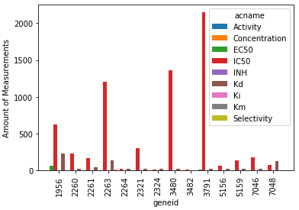
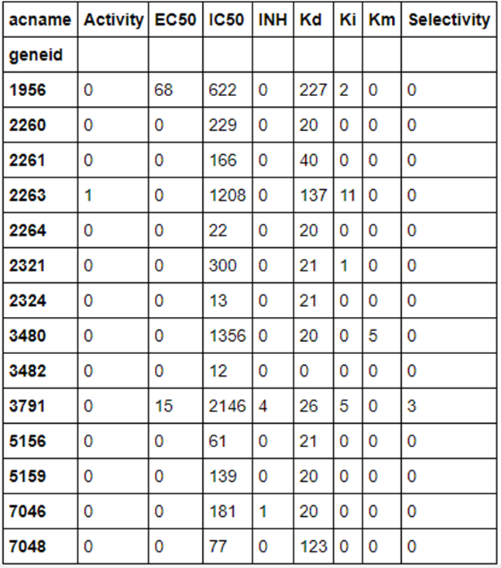
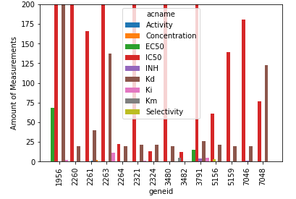
check for useful information: what data do we have that we can use?
Tested Compounds

Slide 37
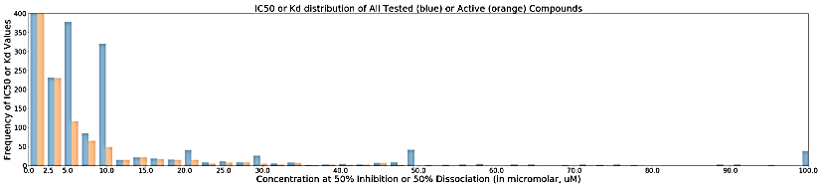
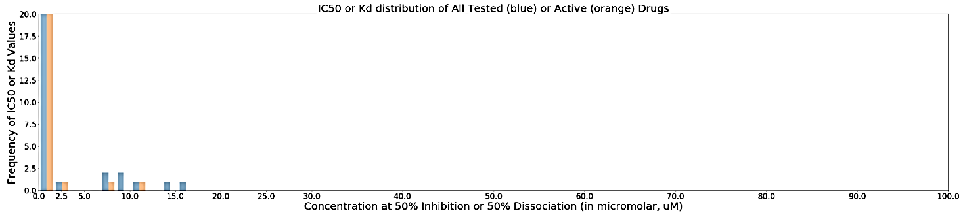
check for useful information: what do our IC50 or Kd values look like?
Tested Compounds
Drugs with Testing Data
start with 0.010uM as a threshold

Slide 38
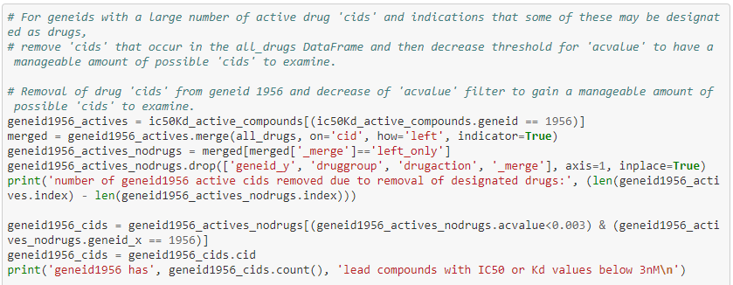


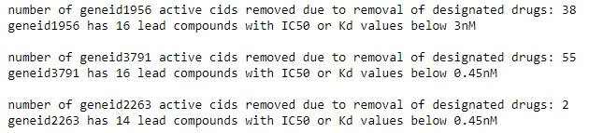
assess target-geneid interactions: clean the DataFrame of Drugs
Filtering the Assayed data to removed already known drugs (DrugBank all_drug list from earlier (inner left merge with a trick – keep only non-drug data).
Then, run a quick Entrez PubChem search against “has DailyMed[filter]” to confirm.

Slide 39
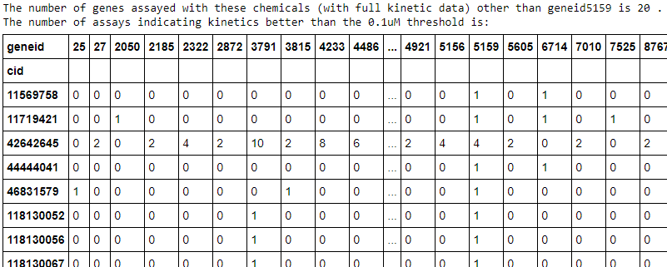
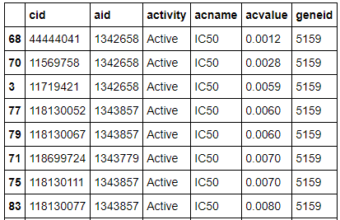
assess off-target geneid interactions
For each geneid, how many other geneids were “hit” by the ‘cid’ at the set threshold?
[‘acvalue’<0.10]
.groupby[‘cid’,‘geneid’].size()…
Remove from
consideration any cid
that hits other geneids!
What are the remaining best ‘acvalues’?
.sort[‘acvalue’]
Select the best 5 ‘cids’ based on lack of “hit” to any other geneids & smallest ‘acvalue’.

